Slide 1
Marketing
Your Lodge
Steve Meier
Area 8 Membership/ Marketing Committee
Susan Ketchum
ISEA Marketing Chair

Slide 2
Marketing is a Tool
Get new members
Create exposure for your lodge
Build public support for what you do
Inspire donations
Provide recognition to your members
Make everyone feel good about what you are doing

Slide 3
Tools are Tools
Marketing is not good or evil
Can be used for noble purposes
Designed to be persuasive
Is also respectful by taking others perspectives into account.
It is efficient when done correctly.
Does not need to be expensive

Slide 4
????What is News????
Is this convention news?
Who knows about it?
Bringing approximately $15-20k into the community
Is that important

Slide 5
News is What the Editor Thinks is News
Designed for whatever the editor believes readers or viewers will think is interesting
Real Goals:
  Sell papers, advertising, etc.
  Change opinion - Propaganda
Is not designed to inform the public

Slide 6
Two Types of News
Voluntary
Is what you create
  “Elks Lodge hands out Thanksgiving
  baskets to kids”
Involuntary
Is unplanned
“Elk’s Member saves a child from Choking”
Can be controlled after its initial release
Prepared statements leading to the event can help you manage this type of news.

Slide 7
News
Must be timely
Must include one of the following:
  Novelty
  Human interest
  Proximity
  Public interest
  Many/donations
  Tragedy/support
  Humor
Notes:
The more you have the better the story will be

Slide 8
Example
This morning, a local Elks Lodge member saved the life of a drowning boy in the Salmon River. The Lodge member later revealed that he wanted to be a lifeguard when he was younger, but twice failed the Red Cross lifesaving tasks.

Slide 9
Is This a Good News Story?
The Lodge members from Salmon Idaho so the story has proximity.
It happened today so the news is timely.
Human interest in the prevention of a drowning.
Irony in the fact the Lodge member to fill the swimming test.

Slide 10
Creating News Events
Stage events that attract news coverage especially on slow news days.
Examples:
  Give a public service award to notable
  public figures or officials
  Give the Citizen of the Year Award.
  Stage a brief reception and presentation program for media
  Take photos of the recipients

Slide 11
Different Population Groups Need to be Marketed Differently
Generational differences matter in marketing
Groups receive information and news differently
Must use different techniques

Slide 12
Baby Boomers
Mid 1940s – Early 1960s
Price, convenience, variety is important
Spend more time online than millennials
They looooove convenience shopping
Ease of use and Price is important
More engaged on Facebook
Will watch a YouTube video all the way through
Respond well to e-mail advertising, value packs, coupons and hard selling

Slide 13
Gen X
Early 1960s – Mid 1980s
Most educated generation in History
Are employed, middle aged parents
Spend more on housing clothing and food than any other generation.
Are very comfortable with high tech gadgets, internet and new technology
Respond better to Old School Advertising
  Direct Mailers, TV commercials
Notes:
Slacker or Latchkey generation
Physical Stores, Direct Mailers, TV commercials

Slide 14
Millennials
Mid 1980s to Early 2000s
Influence and income is low
One in five want to be a CEO
PREFER a formal, strong, and CLEAR hierarchy to get mentorship and get ahead.
Are extremely tech savvy
Value speed, home delivery
Have a strong desire to control their money

Slide 15
Importance for Elks
Are extremely passionate
Want to make a difference in the world
Heavy involvement in social causes
Use Snapchat and Instagram
Notes:
Elks veterans, DAP etc.

Slide 16
Generation Z or iGen
Early 2000 -2020
Pragmatic, frugal, highly diverse.
Spend less time on social media than Millennials
Are smartphone savvy: Use more than anyone
Prefer anonymity and privacy
More accepting, tolerant, open-minded and team-oriented than others
Prefer YouTube followed by Instagram and Snapchat
Watch 2 hours of video per day

Slide 17
Gen Z Advertising Issues
Video marketing is their main exposure of advertising
Not tolerant of typical marketing pitches or hard sell tactics
Content is king for this group

Slide 18
Summary
The way you market depends on the group you are targeting
For Elks Research shows we need to target Gen X and Millennials
  Empty nesters
  People with a passion

Slide 19
Sue begins here

Slide 20
Working With Media
You have lots of competition
Newspapers have limited space
Radio and television stations have limited amount of time
Need a media plan

Slide 21
Plans Always Have Goals
Each aspect of your plan must be written with the goal in mind
Ask the following questions
  A what do I want to accomplish
  How do I accomplish
  When do I accomplish it
  Alternative: Who, what, when, where, how, why

Slide 22
Types of Publicity
News – Press Releases
PSAs
Paid Advertising
Remotes
Community Bulletin Board
Others

Slide 23
tools
Only small circulation newspapers reprint materials verbatim
Editors look for properly style news releases for story leads
Public service directors use public service announcements

Slide 24
Specifics
Keep releases to a single page
After submission, follow-up with a call to the editor
  Top working editor is for major news
  City editor for local interest stories
  Feature editors for specific types of stories
    Business, sports,
Note: With widely distributed materials you won’t have time to contact someone. You have to depend upon the material.

Slide 25
News Releases
Get the most important facts in the first few lines
The Lead:
  Is one sentence, never more than two
  Use who, what, where, when, why, and how

Slide 26
Example
This morning within the capital building, Idaho State Elks Association President Steve Johnson accepted an award from Idaho State Governor Butch Otter in recognition of the Idaho Elks contributions to physical rehabilitation throughout Idaho.

Slide 27
Bridge
Transition from the summary information of the lead to detail information of the rest of the release
Often times the bridge complements the lead

Slide 28
Example
The award was to honor, the Idaho State Elks Association whose organization has donated approximately $10 million over the past two years to assist with physical rehabilitation throughout Idaho

Slide 29
The Body
Is not Jesse Ventura
Fleshes out the facts of the lead with interesting and significant details
Most important facts go first, then others
Use your letterhead if needed. It also reinforces credibility
Mention your position in the Lodge to reinforce your credentials (Public Relations Chair)

Slide 30
Other Details
Is double or triple spaced
Type only on one side of the paper
Give 1.5 inch margins on the left side
At the top of the paper
  Title
  Print page number three times
  Then drop down an inch and continue with the story

Slide 31
Other elements
First page, Upper left, type
  For immediate release
  Can also say embargoed until November 2, 2018
When describing an upcoming event use the words: “News Advisory” as a release line

Slide 32
The Head
Is the title of your release.
It should conceptualize the lead paragraph and grab everyone’s attention.
Example: Elks Pres. receives major award
Upper right part of the page provide contact name and phone number

Slide 33
Helpful Hints
Use
  Short words
  Short sentences
  Short paragraphs
Give exact dates
Check and recheck the facts for accuracy
Never quote someone without permission
Opinion is not appropriate in a release

Slide 34
More Hints
Spell out numbers from 1 to 9, then use numerals
Never begin a sentence with “You.”
Always proofread before sending it out
Have someone else proofread it before sending it out
Give the media the option to interview someone or get involved.

Slide 35
Other Things
Keep conversations with editors short and to the point
Contact editors early in the morning
Good photographs always enhance any press release
Photo should zero in on just a few people: never a group
Make sure everyone is close together
Feel free to stage the shot
Snapshots are unacceptable
Newspapers want black-and-white glossies 5 x 7 first 8 x 10

Slide 36
Public Service Announcements
To get on the air, call the public service director at each broadcast station at least one month prior to the event
Material must be clear, concise, conversational and correct
Use active voice and present tense whenever possible
Example: The Salmon Elks Lodge will sponsor a horseshoe tournament on Saturday, November 4
.

Slide 37
More Information
Do not use unnecessary words
Must sounds conversational
Read it out loud
The Media may want to do it themselves

Slide 38
Tips for interviewing
Dress appropriately
Coat and tie for men, Dresses/Business Suits for women
Avoid bright flashy colors and white
Avoid Green and Blue colors
No plaid or check patterns
Do not use shiny jewelry were a polished high bar
Take everything out of your pockets
Maintain good posture

Slide 39
More tips
.

Slide 40
More Tips
Provide a list of sample questions to the host before the interview
Try to remain relaxed like you chatting with a friend over coffee
Take a couple of water with you
Don’t take plastic bottles that can crackle
Don’t try to bluff your way through a question. If you don’t know say you don’t know
Arrive early
Know your program memorize dates times etc

Slide 41
Analyzing The Demographics of the Audience
Identify which broadcaster is the most appropriate for your message
Know when the peak times are for your target group
High drive times are more expensive than other times

Slide 42
Radio and Television Slots
No Charge Service Announcement Program
Keith Shipman Washington State Association of Broadcasters
Montana added additional slots
Cost 13K

Slide 43
Radio and Television Slots
Common Misconceptions
  Expensive
  Not worth the effort.
What did you listen to coming to the Convention?
Montana
  Radio Blasts across Montana
  TV slots across Montana

Slide 44
  Steve seturns

Slide 45
So, Who is Your Target?
Three Groups
  21-25
  30-40
  40-55

Slide 46
What is Goal?
Increase exposure
Increase membership
Provide information to Elks Members
Provide information to the community
Toot our horn

Slide 47
What Techniques Will You Use?
Depends on the target group
Print, Banners, Fliers, Social Media, email
Grand Lodge has materials
  Some are older
Must be appropriate for the target group
Must be dynamic and vibrant
  Do not use Black and White
Need to consider cost
  Many techniques are cheap or free

Slide 48
What is Your Message?
Informative
  We are doing “X”
  “Z” received an award
Promotional
  “__” Lodge contributed $50,000 to our community this year.
Assistance
  Help the Elk assist veterans

Slide 49
Does Your Lodge Have a Tag?
E.g., Elks Care, Elks Share
Idaho Elks, where members help
  Veterans
  Youth read
  Idaho Elks Rehab. Where Elks Make a Physical Difference

Slide 50
EXPOSURE IS EVERYTHNG
NO EXPOSURE, YOU DO NOT EXIST

Slide 51
Lodge Promotion
Provides a message to your community
Provides a message to potential members
Lets your current members know what is happening
Gets everyone excited

Slide 52
Different Population Groups Send and Receive Information Differently
Older members - Print Media
Middle Age Members - email
Young Adults - Social Media
Current Younger Adults – Text
Which method does your lodge use?

Slide 53
Strategies
Outdoor Branding
Indoor Branding
Fliers and Brochures
Media
  Print
  Radio
  TV slots
Social Media

Slide 54
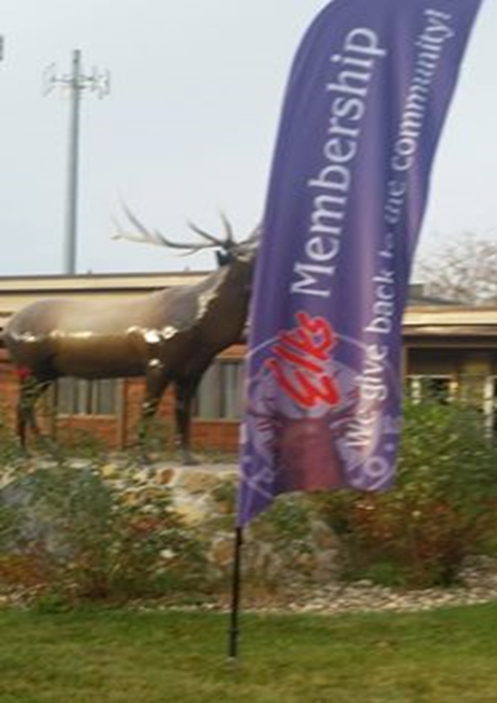

OUTDOOR BRANDING

Slide 55


Slide 56


Slide 57
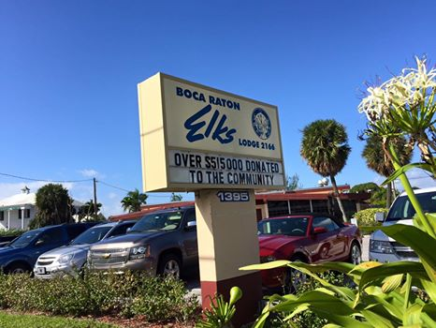

Slide 58
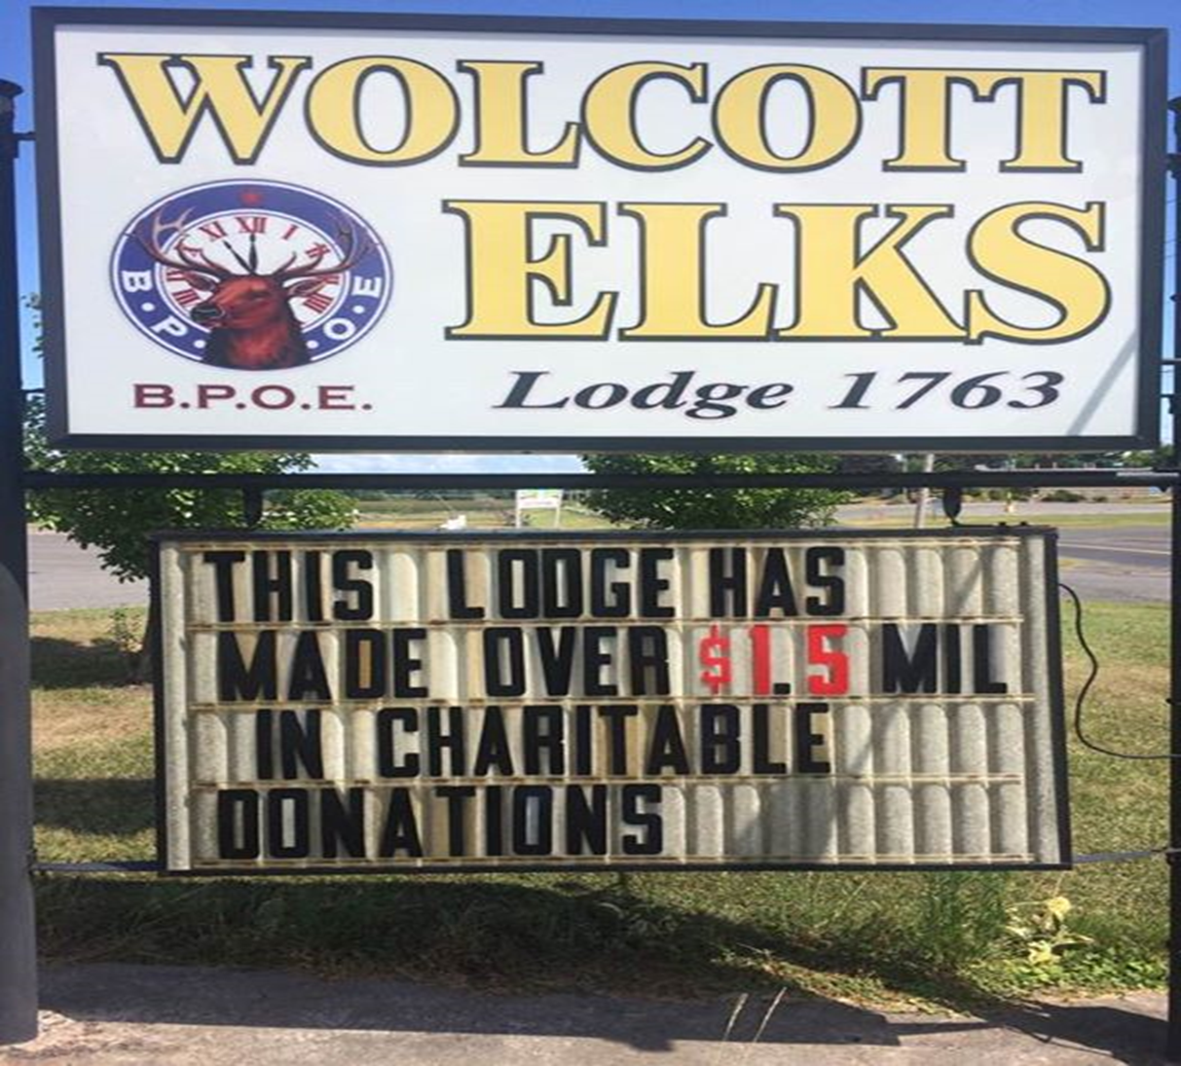

Slide 59
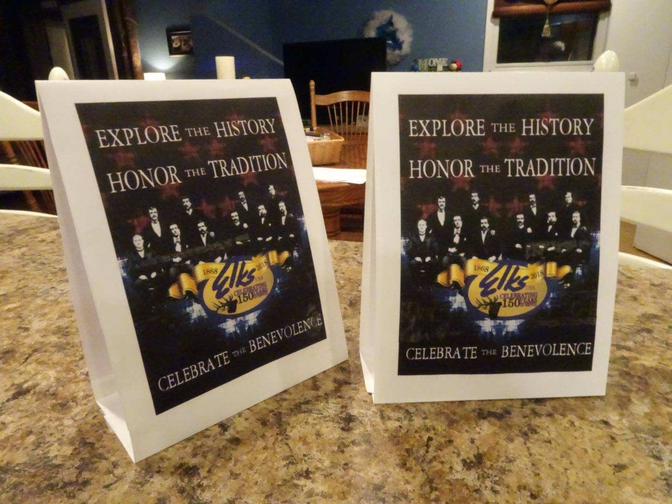
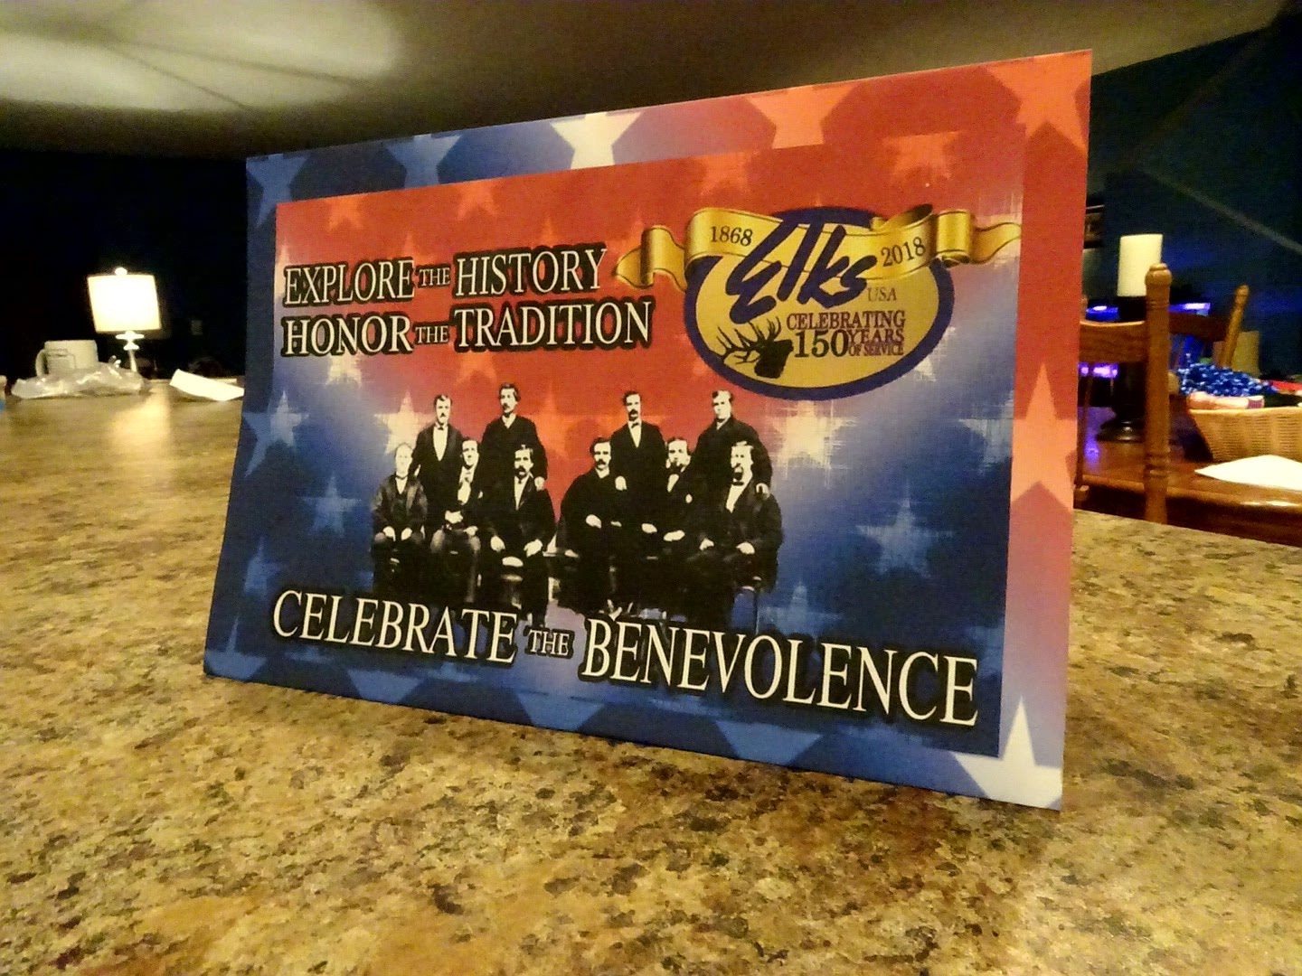
INDOOR BRANDING
TENT CARDS & PLACEMATS

Slide 62
Local Print Media
Newspaper placements
Letters to the Editor
Who, What, When, Where, Why
Provide photo’s
Provide Narrative (Before and After)
What makes your topic interesting?
How can it sell papers!!!

Slide 63
Innovative Ideas
Materials on reader boards in rest stops promoting Elks
Materials for billboards when not occupied

Slide 64
Summary
Lots of information
ERs need to be working with their Secretary, Membership and Marketing/Publicity chairs
Develop a plan
Marketing takes work
The payoff is worth it.

Slide 65
REMEMBER
EXPOSURE IS EVERYTHNG
NO EXPOSURE, YOU DO NOT EXIST

Slide 66
Question
Are you going to use this information
If so, how
What can we do to help you?

Slide 67
Comments

